Slide 1

Workshop Outline
What You Stand to Gain in This Community
DevOps Overview
What is git
How does git work
Making Our First Contribution

Slide 2
What You Stand to Gain in This Community
Accountability: Stay on track with your DevOps journey through consistent check-ins and shared goals.
Learning Together: Collaborate and grow with fellow DevOps enthusiasts, sharing knowledge and experiences.
Structured Roadmap: Follow a clear and organized path to mastering DevOps skills over 90 days.
Community Support: Get help, feedback, and motivation from a group of like-minded individuals.
Practical Experience: Gain hands-on experience through real-world projects and contributions.
Networking Opportunities: Connect with peers and industry professionals to expand your network.

Slide 3
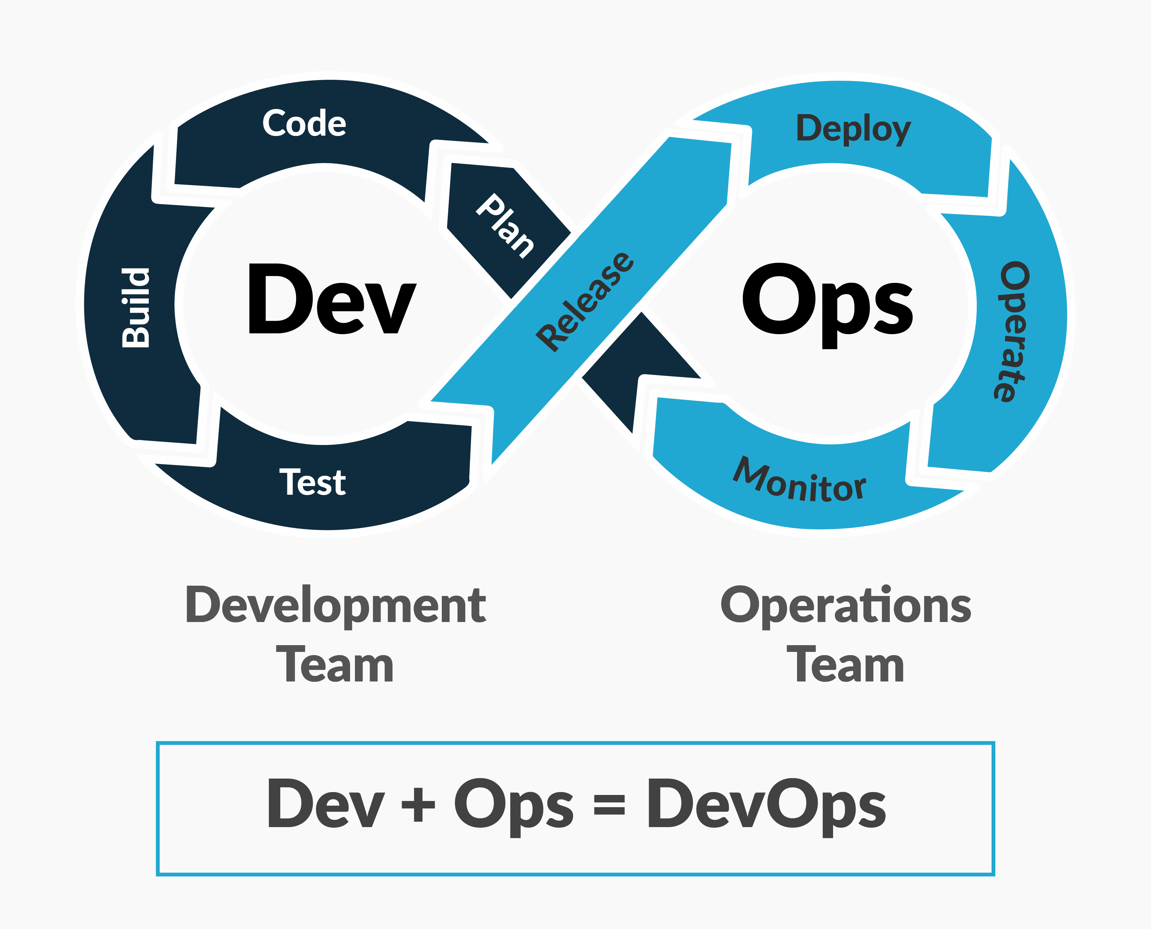

Slide 4
What is git 🤔
Git is a powerful version control system that tracks changes in your code over time. It allows multiple people to work on the same project simultaneously without interfering with each other’s work.
For instance, Imagine you’re working on a coding project and accidentally delete a crucial file. With Git, you can easily revert to a previous version of your project and recover the lost work. Git acts like a time machine, allowing you to travel back to any point in your project’s history.
Key Features of Git:
Version Control: Keep track of changes in your code.
Branching and Merging: Work on different features or fixes simultaneously and merge them when ready.
Distributed System: Everyone has a full project copy, ensuring no data is lost.

Slide 5
How Does git Works🛠️
Git creates a snapshot of your project each time you commit changes. These snapshots are stored in a repository, and you can switch between them.
Important Git Commands:
git init: Initializes a new Git repository.
git clone <repository-url>: Clones an existing repository to your local machine.
git add <file>: Adds changes in the specified file(s) to the staging area.
git commit -m "message": Commits the staged changes to the repository with a descriptive message.
git status: Shows the current status of your working directory and staging area.
git log: Displays the commit history.
git branch: Lists all branches in the repository or creates a new branch.
git checkout <branch-name>: Switches to the specified branch.
git merge <branch-name>: Merges the specified branch into the current branch.
git push: Uploads your local repository changes to a remote repository (e.g., GitHub).
git pull: Fetches and merges changes from the remote repository to your local repository.

Slide 6
Making Our First Contribution 🌱

